Slide 1


Slide 2
Microsoft Cognitive Services: Give your Apps a Human Side
Vishesh Oberoi
Technical Evangelist, Microsoft
@ovishesh

Slide 3

Leading the journey to the Cloud
SAAS Solutions
Microsoft Dynamics
Enterprise Mobility
Microsoft Enterprise Mobility Suite
Microsoft Azure
Developer + App Platform
Visual Studio Family + Azure App Service
Data + Analytics
Cortana Intelligence Suite
Internet of Things
Azure IoT Suite
Cloud Infrastructure
Azure + Azure Stack + Operations Management Suite

Slide 4
Hybrid capabilities
tools
Visual Studio + Visual Studio Code + Visual Studio Team Services + Xamarin
Advanced Workloads
Microsoft Azure
Web + Mobile Internet of Things
Microservices
Data + Analytics
Identity Management
Media Streaming
High Performance Compute
Cognitive Services
CORE Infrastructure
Compute Storage Networking Security

Slide 5



Stay ahead of the curve with Cortana Intelligence Suite
Business apps
People
Custom apps
Apps
Sensors and devices
Cortana Intelligence
Automated systems
Data
Intelligence
Action
Notes:
Cortana Intelligence is Microsoft’s fully managed intelligent, big data and advanced analytics offering in the cloud, designed to help you transform your data into intelligent action.
It is a comprehensive suite that brings together technologies throughout Microsoft. It provides fast and flexible deployment, with a simple monthly subscription to reduce time and cost challenges.
Cortana Intelligence enables customers to benefit from Microsoft’s investment in the intelligent cloud and advanced analytics, spanning our leading cloud platform with easy to use tools and services that integrate with existing infrastructure and enable enterprises to extend business solutions as their needs grow over time.
With Cortana Intelligence, we are taking years of research and innovation – spanning technology & infrastructure for advanced analytics, including capabilities such as machine learning, big data storage and processing in the cloud, intelligence capabilities like vision, face and speech recognition, and integration with Cortana, Microsoft’s personal digital assistant, with the goal of helping enterprise customers make better, faster decisions to accelerate their speed of business.
<Transition>: Let’s talk about how some of our customers are benefiting from Cortana Intelligence.

Slide 6

Microsoft Cognitive Services preview
Vision
From faces to feelings, allow your apps to understand images and video
Cognitive Services
Give your solutions a human side
Speech
Hear and speak to your users by filtering noise, identifying speakers, and understanding intent
Language
Process text and learn how to recognize what users want
Knowledge
Tap into rich knowledge amassed from the web, academia, or your own data
Search
Access billions of web pages, images, videos, and news with the power of Bing APIs
Notes:
What are Cognitive Services? Microsoft Cognitive Services are a new collection of intelligence and knowledge APIs that enable developers to ultimately build smarter apps.

Slide 7
Microsoft Cognitive Services preview
Vision
Computer Vision | Emotion | Face | Video
Cognitive Services
Give your solutions a human side
Speech
Custom Recognition | Speaker Recognition Speech
Language
Bing Spell Check | Language Understanding Linguistic Analysis | Text Analytics | Web Language Model
Knowledge
Academic Knowledge | Entity Linking Knowledge Exploration | Recommendations
Search
Bing Auto Suggest | Bing Image Search | Bing News Search Bing Video Search | Bing Web Search
Notes:
At Microsoft, we’ve been offering APIs for a very long time across the company. In delivering Microsoft Cognitive Services API, we started with 4 last year at /build (2015); added 7 more last December, and today we have 22 APIs in our collection.
Cognitive Services are available individually or as a part of the Cortana Intelligence Suite, formerly known as Cortana Analytics, which provides a comprehensive collection of services powered by cutting-edge research into machine learning, perception, analytics and social bots.
These APIs are powered by Microsoft Azure.
Developers and businesses can use this suite of services and tools to create apps that learn about our world and interact with people and customers in personalized, intelligent ways.

Slide 8
Demo

Slide 9

Computer Vision APIs
Analyze an image Understand content within an image
OCR Detect and recognize words within an image
Generate thumbnail Scale and crop images, while retaining key content
Notes:
Do you need an API that gives you actionable information about images used in your app? The Computer Vision API gives you the tools to understand the contents of any image. Create tags identifying objects, beings, or actions present in the image, and then craft coherent sentences to describe it. Whether you want to execute better image search, or you want to create an assistive app for the visually impaired, the Computer Vision API helps get the job done.

Slide 10
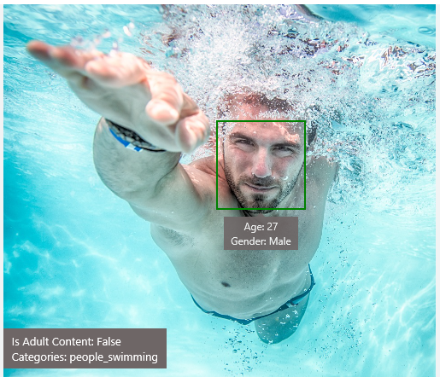
Analyze image
Type of image
Clip Art Type 0 Non-clipart
Line Drawing Type 0 Non-Line Drawing
Black & White Image False
Content of image
Categories [{ “name”: “people_swimming”, “score”: 0.099609375 }]
Adult Content False
Adult Score 0.18533889949321747
Faces [{ “age”: 27, “gender”: “Male”, “faceRectangle”: {“left”: 472, “top”: 258, “width”: 199, “height”: 199}}]
Image colors
Dominant Color Background White
Dominant Color Foreground Grey
Dominant Colors White
Accent Color

Slide 11

OCR
Good at
JSON:
{
"language": "en",
"orientation": "Up",
"regions": [
{
"boundingBox": "41,77,918,440",
"lines": [
{
"boundingBox": "41,77,723,89",
"words": [
{
"boundingBox": "41,102,225,64",
"text": "LIFE"
},
{
"boundingBox": "356,89,94,62",
"text": "IS"
},
{
"boundingBox": "539,77,225,64",
"text": "LIKE"
}
. . .
Scanned documents
Photos with text
Fine grained location information
LIFE IS LIKE
RIDING A BICYCLE
TO KEEP YOUR BALANCE
YOU MUST KEEP MOVING
Need to improve
Vehicle license plate
Hand-written text
Characters with large sizes

Slide 12
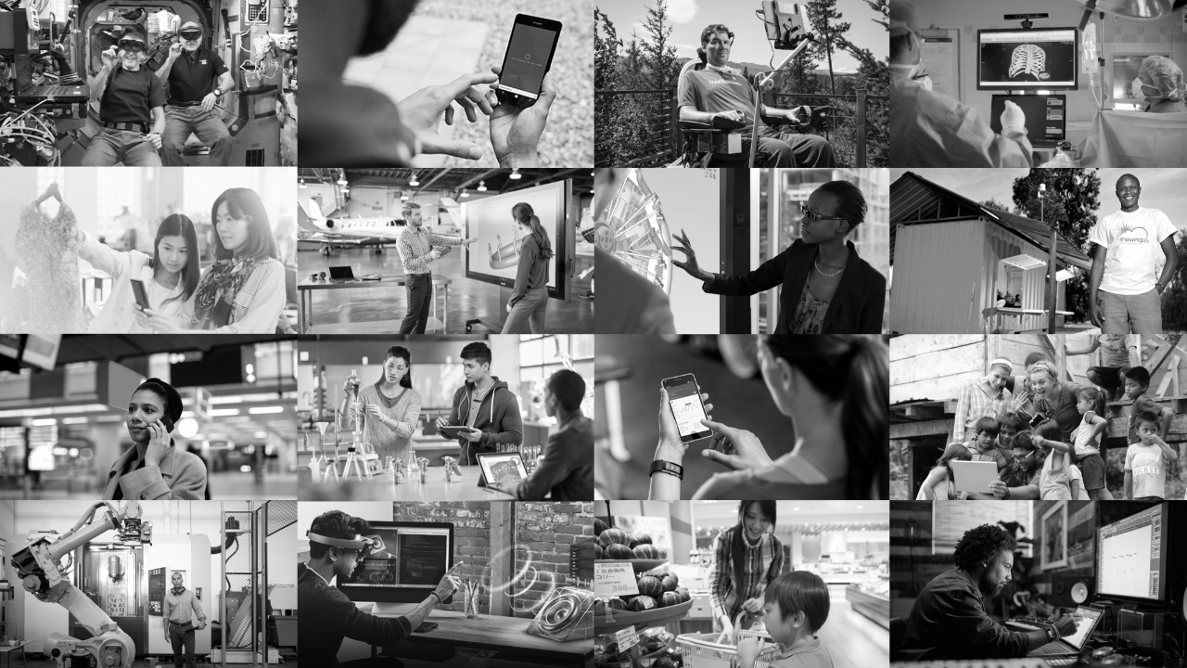
Imagine what’s possible…
Notes:
We want to take that power of human language and apply it more pervasively to all of the computing interface and the computing interaction. To do that, you have to infuse intelligence into the computers and computing around us.
We will use artificial intelligence and machine learning so that we can teach computers to learn human language, and have conversational understanding, while teaching them about the broad context — the people, places, things, that make up your day to day — so that they can really help you with your everyday tasks and everyday life, both at work and elsewhere.
As we infuse intelligence into everything, we will have a thoughtful, principled approach, a way to guide our design and the way we innovate. This approach is grounded in our mission to empower people and organizations all over the planet to achieve more.

